Slide 1
Data and Computer Communications
Chapter 3 – Data Transmission

Slide 2
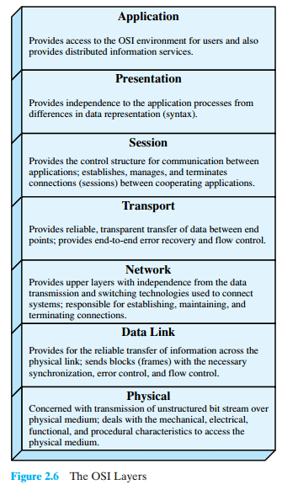
OSI Layers

Slide 3
Transmission Terminology
Data transmission occurs between a transmitter & receiver via some medium
Guided medium
  E.g. twisted pair, coaxial cable, optical fiber
Unguided / wireless medium
  E.g. air, water, vacuum
Notes:
The first section presents some concepts and terms from the field of electrical engineering. This should provide sufficient background to deal with the remainder of the chapter. Data transmission occurs between transmitter and receiver over some transmission medium. Transmission media may be classified as guided or unguided. In both cases, communication is in the form of electromagnetic waves. With guided media, the waves are guided along a physical path; examples of guided media are twisted pair, coaxial cable, and optical fiber. Unguided media, also called wireless, provide a means for transmitting electromagnetic waves but do not guide them; examples are propagation through air, vacuum, and seawater.

Slide 4
Transmission Terminology
Direct link
  no intermediate devices
Point-to-point
  direct link
  only 2 devices share link
Multi-point
  more than two devices share the link
Notes:
The term direct link is used to refer to the transmission path between two devices in which signals propagate directly from transmitter to receiver with no intermediate devices, other than amplifiers or repeaters used to increase signal strength. A guided transmission medium is point to point if it provides a direct link between two devices and those are the only two devices sharing the medium. In a multipoint guided configuration, more than two devices share the same medium.

Slide 5
Transmission Terminology
Simplex
  one direction
    E.g. television
Half duplex
  either direction, but only one way at a time
    E.g. police radio
Full duplex
  both directions at the same time
    E.g. telephone
Notes:
A transmission may be simplex, half duplex, or full duplex. In simplex transmission, signals are transmitted in only one direction; one station is transmitter and the other is receiver. In half-duplex operation, both stations may transmit, but only one at a time. In full-duplex operation, both stations may transmit simultaneously, and the medium is carrying signals in both directions at the same time.
We should note that the definitions just given are the ones in common use in the United States (ANSI definitions). Elsewhere (ITU-T definitions), the term simplex is used to correspond to half duplex and duplex is used to correspond to full duplex.

Slide 6
Frequency, Spectrum and Bandwidth
Time domain concepts
  Analog signal
    Varies in a smooth way over time
  Digital signal
    Maintains a constant level then changes to another constant level
  Periodic signal
    Pattern repeated over time
  Aperiodic signal
    Pattern not repeated over time
Notes:
In this book, we are concerned with electromagnetic signals used as a means to transmit data. The signal is a function of time, but it can also be expressed as a function of frequency; that is, the signal consists of components of different frequencies. It turns out that the frequency domain view of a signal is more important to an understanding of data transmission than a time domain view.
Viewed as a function of time, an electromagnetic signal can be either analog or digital. An analog signal is one in which the signal intensity varies in a smooth fashion over time. A digital signal is one in which the signal intensity maintains a constant level for some period of time and then abruptly changes to another constant level. This is an idealized definition. In fact, the transition from one voltage level to another will not be instantaneous, but there will be a small transition period.
The simplest sort of signal is a periodic signal, in which the same signal pattern repeats over time. Otherwise, a signal is aperiodic.

Slide 7
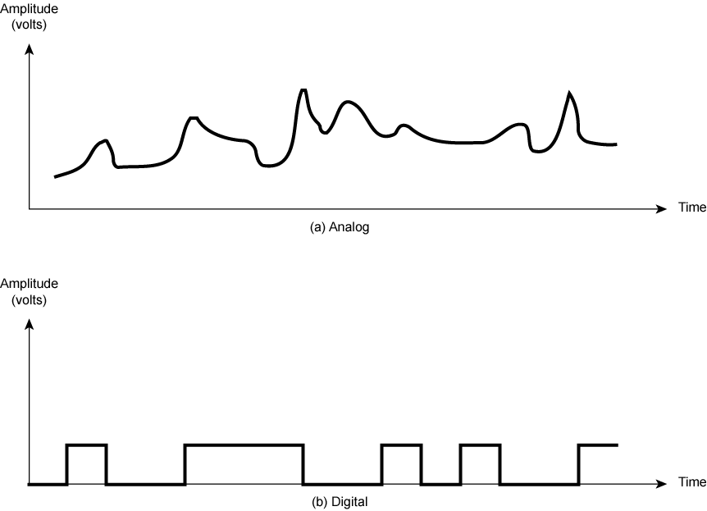
Analog & Digital Signals
Notes:
Stallings DCC8e Figure 3.1 shows an example of both analog or digital signals. The continuous signal might represent speech, and the discrete signal might represent binary 1s and 0s.

Slide 8
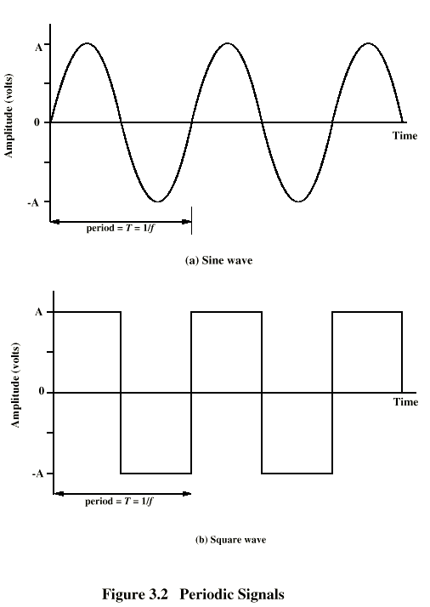
Periodic
Signals
Signal is periodic if and only if:
s(t + T) = s(t),
-∞ < t < +∞
T is the period of the signal
Notes:
In Stallings DCC8e Figure 3.2 a signal is generated by the transmitter and transmitted over a medium. The signal is a function of time, but it can also be expressed as a function of frequency; that is, the signal consists of components of different frequencies. It turns out that the frequency domain view of a signal is more important to an understanding of data transmission than a time domain view. Both views are introduced here.

Slide 9
Sine Wave
Peak amplitude (A)
  Maximum strength of signal
  Volts
Frequency (f)
  Rate of change of signal
  Hertz (Hz) or cycles per second
  Period = time for one repetition (T)
  T = 1/f
Phase (φ)
  Relative position in time
Notes:
The sine wave is the fundamental periodic signal. A general sine wave can be represented by three parameters:
peak amplitude (A) - the maximum value or strength of the signal over time; typically measured in volts.
frequency (f) - the rate [in cycles per second, or Hertz (Hz)] at which the signal repeats. An equivalent parameter is the period (T) of a signal, so T = 1/f.
phase (φ) - measure of relative position in time within a single period of a signal, illustrated subsequently

Slide 10
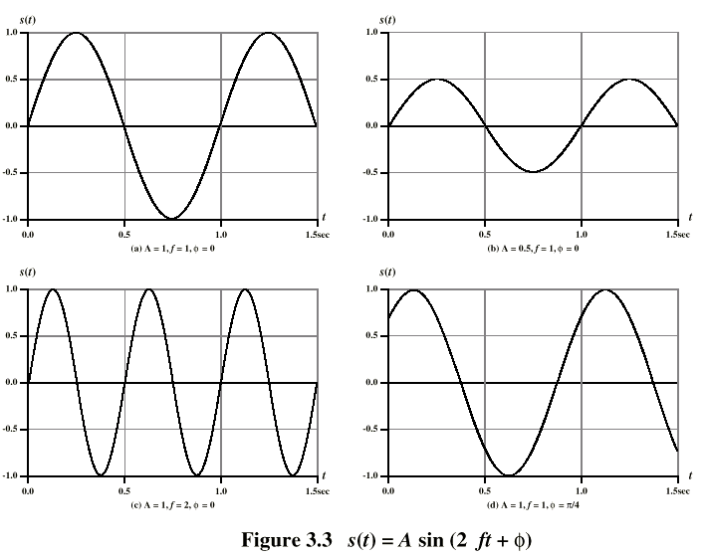
Varying Sine Waves s(t) = A sin(2πft +Φ)
Notes:
The general sine wave can be written as: s(t) = A sin(2πft + φ), known as a sinusoid function.
Stallings DCC8e Figure 3.3 shows the effect of varying each of the three parameters, the horizontal axis is time; the graphs display the value of a signal at a given point in space as a function of time. In part (a) of the figure, the frequency is 1 Hz; thus the period is T = 1 second. Part (b) has the same frequency and phase but a peak amplitude of 0.5. In part (c) we have f = 2, which is equivalent to T = 0.5. Finally, part (d) shows the effect of a phase shift of π/4 radians, which is 45 degrees (2π radians = 360˚ = 1 period).
These same graphs, with a change of scale, can apply with horizontal axes in space. In this case, the graphs display the value of a signal at a given point in time as a function of distance.

Slide 11
Wavelength (λ)
Distance occupied by one cycle
Distance between two points of corresponding phase of two consecutive cycles
Assuming signal velocity v, we have λ = vT
Or equivalently, λf = v
Especially when v=c
  c = 3*10⁸ ms⁻¹ (speed of light in free space)
Notes:
There is a simple relationship between the two sine waves, one in time and one in space. The wavelength (λ) of a signal is the distance occupied by a single cycle, or, put another way, the distance between two points of corresponding phase of two consecutive cycles. Assume that the signal is traveling with a velocity v. Then the wavelength is related to the period as follows: λ = vT. Equivalently, λf = v. Of particular relevance to this discussion is the case where v = c, the speed of light in free space, which is approximately 3 × 10⁸ m/s.

Slide 12
Frequency Domain Concepts
Signals are made up of many frequencies
Components are sine waves
Fourier analysis can show that any signal is made up of component sine waves
Can plot frequency domain functions
Notes:
In practice, an electromagnetic signal will be made up of many frequencies. It can be shown, using a discipline known as Fourier analysis, that any signal is made up of components at various frequencies, in which each component is a sinusoid. By adding together enough sinusoidal signals, each with the appropriate amplitude, frequency, and phase, any electromagnetic signal can be constructed.

Slide 13
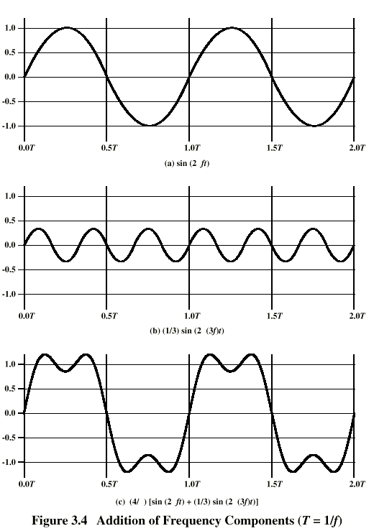
Addition of
Frequency
Components
(T=1/f)
π
Figure (c) represents sum of signals with frequencies f and 3f
π
π
π
π
Notes:
In Stallings DCC8e Figure 3.4c, the components of this signal are just sine waves of frequencies f and 3f, as shpwn in parts (a) and (b).

Slide 14
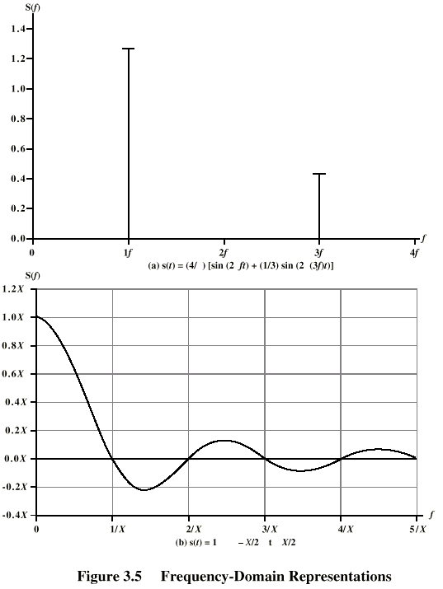
Frequency
Domain
Representations
Frequency domain function of Fig. (c)
Frequency domain function of single square pulse
π
π
π
<
<
Notes:
So we can say that for each signal, there is a time domain function s(t) that specifies the amplitude of the signal at each instant in time. Similarly, there is a frequency domain function S(f) that specifies the peak amplitude of the constituent frequencies of the signal.
In Stallings DCC8e Figure 3.5a shows the frequency domain function for the signal of Figure 3.4c. Note that, in this case, S(f) is discrete. Figure 3.5b shows the frequency domain function for a single square pulse that has the value 1 between –X/2 and X/2, and is 0 elsewhere. Note that in this case S(f) is continuous and that it has nonzero values indefinitely, although the magnitude of the frequency components rapidly shrinks for larger f. These characteristics are common for real signals.

Slide 15
Spectrum & Bandwidth
Spectrum
  Range of frequencies contained in signal
Absolute bandwidth
  Width of spectrum
Effective bandwidth
  Often just bandwidth
  Narrow band of frequencies containing most energy
DC Component
  Component of zero frequency
Notes:
The spectrum of a signal is the range of frequencies that it contains. For Stallings DCC8e Fig 3.4c, it extends from f to 3f.
The absolute bandwidth of a signal is the width of the spectrum (eg is 2f in Fig 3.4c. Many signals, such as that of Figure 3.5b, have an infinite bandwidth.
Most of the energy in the signal is contained in a relatively narrow band of frequencies known as the effective bandwidth, or just bandwidth.
If a signal includes a component of zero frequency, it is a direct current (dc) or constant component.

Slide 16
Data Rate and Bandwidth
Any transmission system has a limited band of frequencies
This limits the data rate that can be carried
Square has infinite components and hence bandwidth
But most energy is in first few components
Limited bandwidth increases distortion
There is a direct relationship between data rate & bandwidth
Notes:
Although a given waveform may contain frequencies over a very broad range, as a practical matter any transmission system (transmitter plus medium plus receiver) will be able to accommodate only a limited band of frequencies. This, in turn, limits the data rate that can be carried on the transmission medium.
A square wave has an infinite number of frequency components and hence an infinite bandwidth. However, the peak amplitude of the kth frequency component, kf, is only 1/k, so most of the energy in this waveform is in the first few frequency components.
In general, any digital waveform will have infinite bandwidth. If we attempt to transmit this waveform as a signal over any medium, the transmission system will limit the bandwidth that can be transmitted. For any given medium, the greater the bandwidth transmitted, the greater the cost. The more limited the bandwidth, the greater the distortion, and the greater the potential for error by the receiver.
There is a direct relationship between data rate and bandwidth: the higher the data rate of a signal, the greater is its required effective bandwidth.

Slide 17
Data Rate Calculation
Case 1
  Bandwidth 4MHz, use the sine wave of Fig. 3-7 (a)
  4MHz = 5f – f → f = 1MHz,
  the period of fundamental frequency →1/f = 10⁻⁶ = 1us. One wave takes two data bits
  Data rate = 2 Mbps
Case 2
  Bandwidth 8MHz, use the sine wave of Fig. 3-7 (a)
  8MHz = 5f – f → f = 2MHz
  Data rate = 4 Mbps
Case 3
  Bandwidth 4MHz, use the sine wave of Fig. 3-4 (c)
  4MHz = 3f – f → f = 2MHz Data rate = 4 Mbps

Slide 18
Data Rate vs. Bandwidth
Bandwidth ↑
  Data rate ↑ (compare case 1 & 2)
  Same signal quality
Same bandwidth
  Higher signal quality → lower data rate
  Compare case 1 & 3
Same data rate
  Bandwidth ↑ → better signal quality
  Compare case 2 & 3

Slide 19
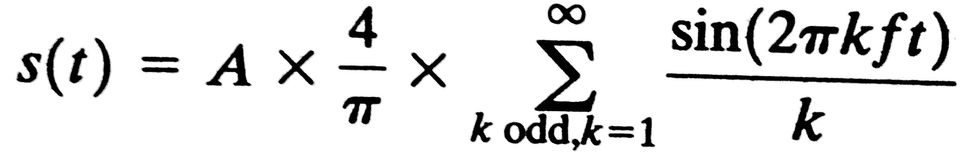
Square Wave
Frequency components of the square wave with amplitudes A and –A can be expressed as:
π
π
π
The waveform has an infinite number of frequency components and hence an infinite bandwidth.
Peak amplitude of the kth frequency component, kf, is only 1/k; most of the energy is in first few freq. components.
Limiting waveform to the first few freq. components generates a waveform reasonably close to that of the original square wave.
<
<
Notes:
So we can say that for each signal, there is a time domain function s(t) that specifies the amplitude of the signal at each instant in time. Similarly, there is a frequency domain function S(f) that specifies the peak amplitude of the constituent frequencies of the signal.
In Stallings DCC8e Figure 3.5a shows the frequency domain function for the signal of Figure 3.4c. Note that, in this case, S(f) is discrete. Figure 3.5b shows the frequency domain function for a single square pulse that has the value 1 between –X/2 and X/2, and is 0 elsewhere. Note that in this case S(f) is continuous and that it has nonzero values indefinitely, although the magnitude of the frequency components rapidly shrinks for larger f. These characteristics are common for real signals.

Slide 20
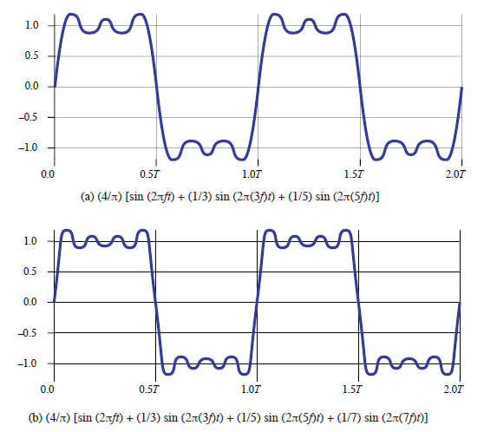
Square Wave: Freq. Components

Slide 21
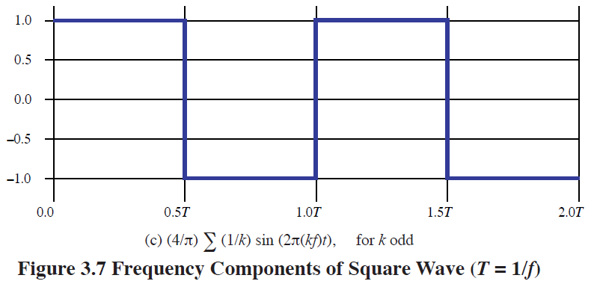
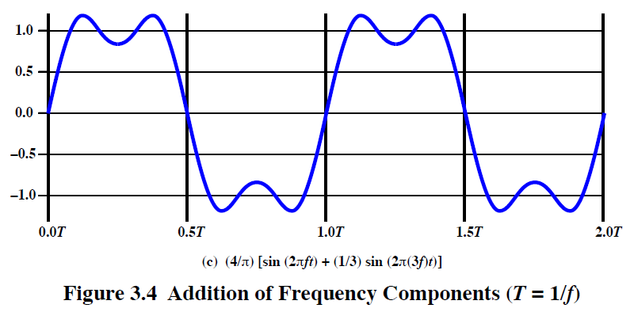
Bit time = T / 2

Slide 22
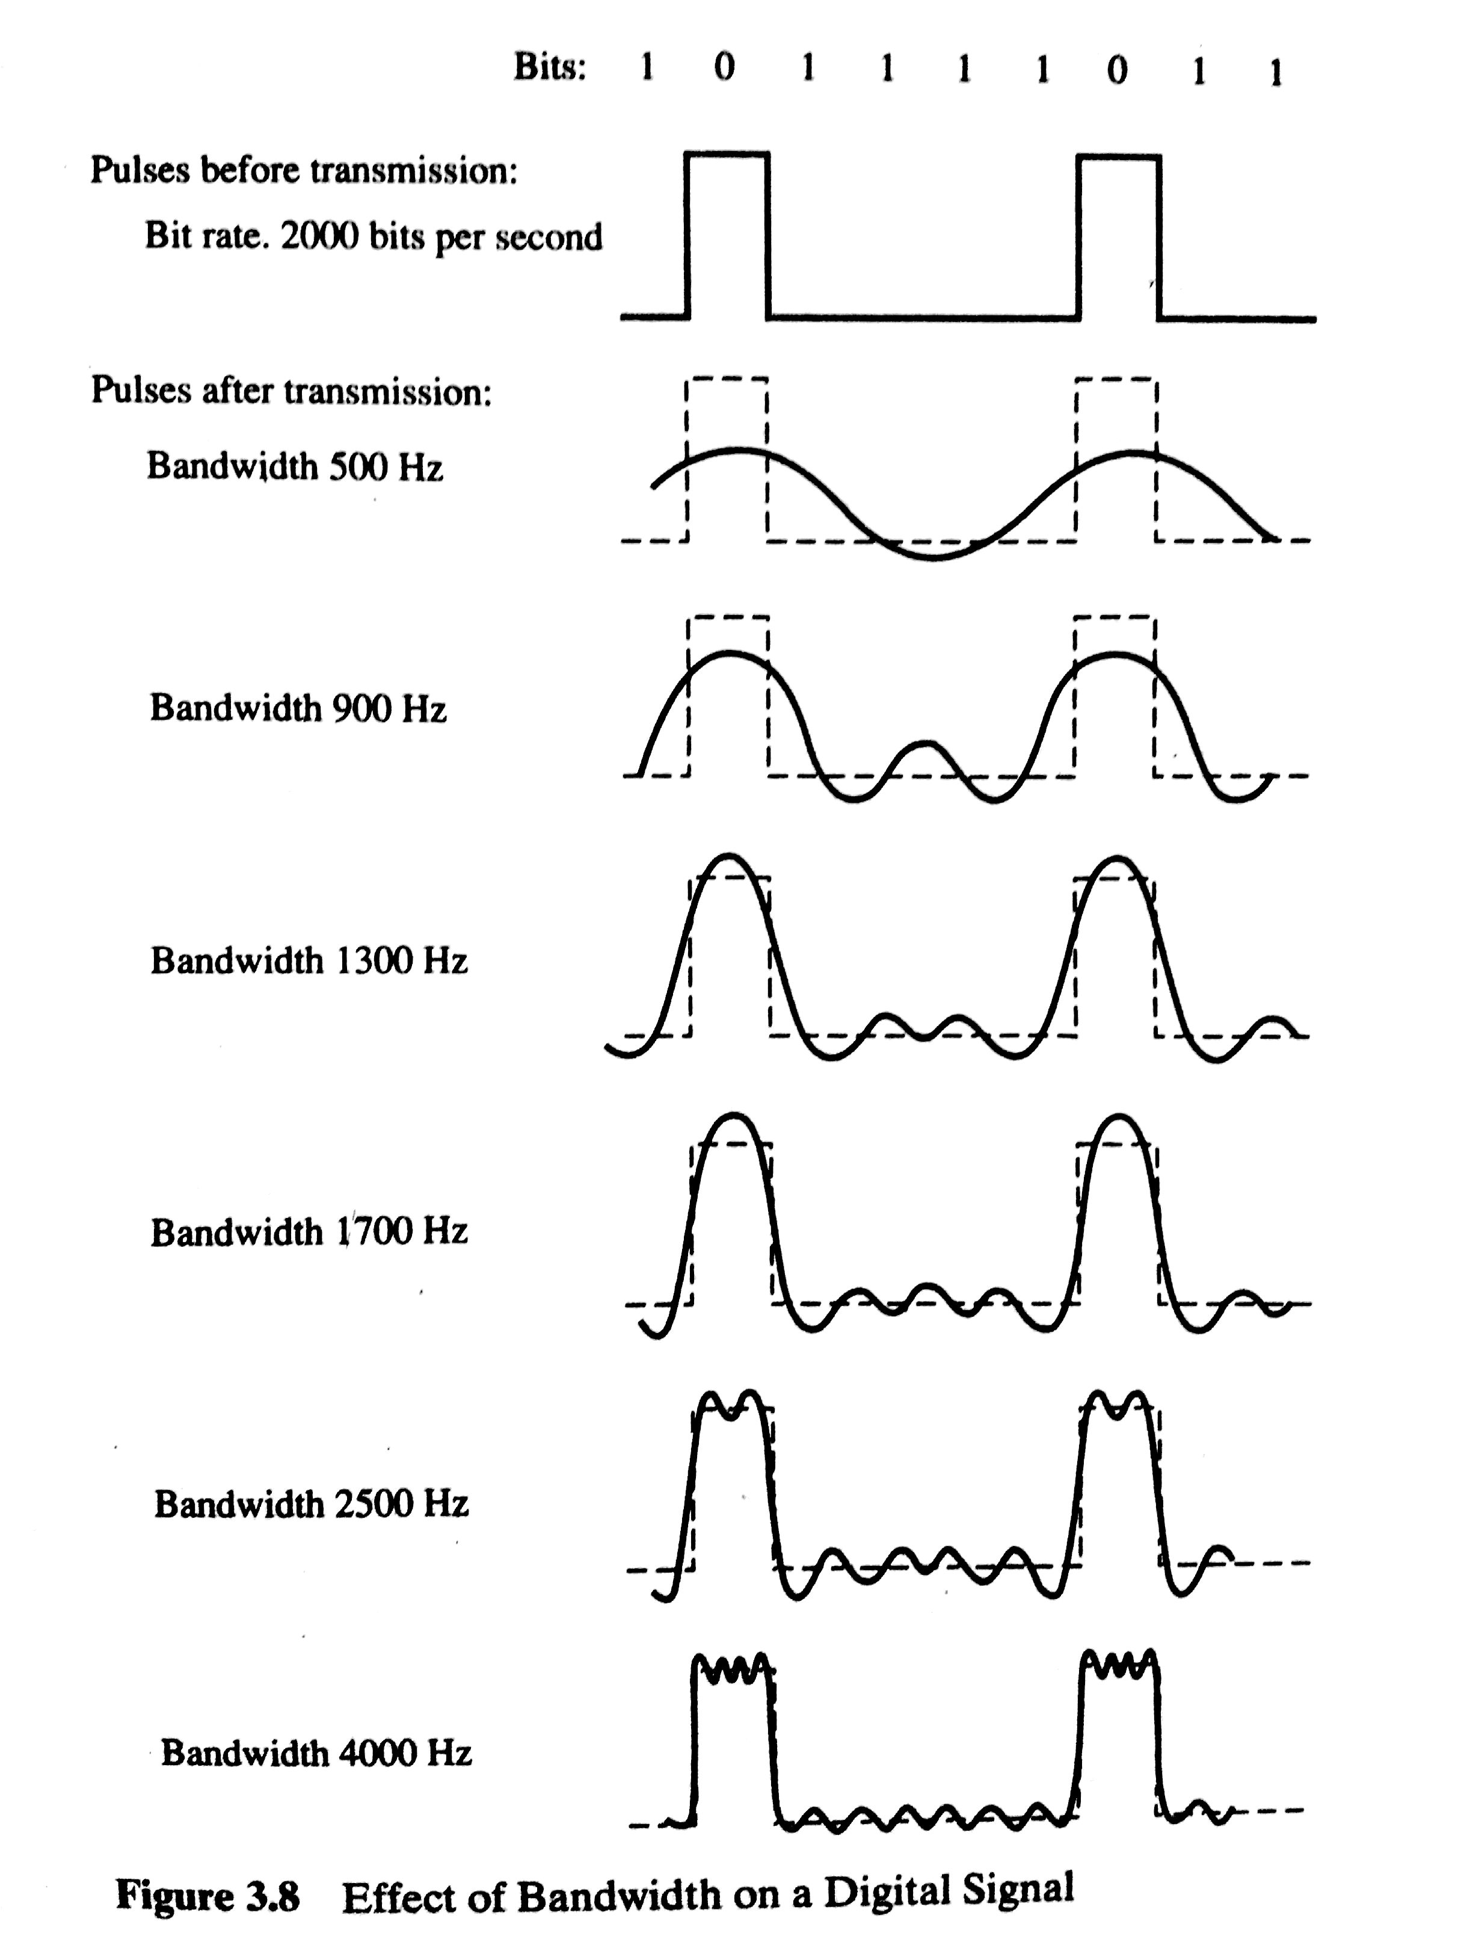
Effect of Bandwidth on a Digital Signal

Slide 23
Transmission Impairments
Signal received may differ from signal transmitted causing:
  Analog - degradation of signal quality
  Digital - bit errors
Most significant impairments are
  Attenuation and attenuation distortion
  Delay distortion
  Noise
Notes:
With any communications system, the signal that is received may differ from the signal that is transmitted due to various transmission impairments. For analog signals, these impairments can degrade the signal quality. For digital signals, bit errors may be introduced, such that a binary 1 is transformed into a binary 0 or vice versa.

Slide 24
Attenuation
Where signal strength falls off with distance
Depends on medium
Received signal strength must be:
  Strong enough to be detected
  Sufficiently higher than noise to receive without error
So increase strength using amplifiers/repeaters
Is also an increasing function of frequency
So equalize attenuation across band of frequencies used
  E.g. using loading coils or amplifiers
Notes:
Attenuation is where the strength of a signal falls off with distance over any transmission medium. For guided media, this is generally exponential and thus is typically expressed as a constant number of decibels per unit distance. For unguided media, attenuation is a more complex function of distance and the makeup of the atmosphere. See Stallings DCC8e Figure 3.11 on previous slide for illustration of attenuation.
Attenuation introduces three considerations for the transmission engineer. First, a received signal must have sufficient strength so that the electronic circuitry in the receiver can detect the signal. Second, the signal must maintain a level sufficiently higher than noise to be received without error. Third, attenuation varies with frequency. The first and second problems are dealt with by attention to signal strength and the use of amplifiers or repeaters. The third problem is particularly noticeable for analog signals. To overcome this problem, techniques are available for equalizing attenuation across a band of frequencies. This is commonly done for voice-grade telephone lines by using loading coils that change the electrical properties of the line; the result is to smooth out attenuation effects. Another approach is to use amplifiers that amplify high frequencies more than lower frequencies.

Slide 25
Delay Distortion
Only occurs in guided media
Propagation velocity varies with frequency
Hence various frequency components arrive at different times
Particularly critical for digital data
Since parts of one bit spill over into others
Causing inter-symbol interference
Notes:
Delay distortion occurs because the velocity of propagation of a signal through a guided medium varies with frequency. For a bandlimited signal, the velocity tends to be highest near the center frequency and fall off toward the two edges of the band. Thus various frequency components of a signal will arrive at the receiver at different times, resulting in phase shifts between the different frequencies. Delay distortion is particularly critical for digital data, because some of the signal components of one bit position will spill over into other bit positions, causing intersymbol interference. This is a major limitation to maximum bit rate over a transmission channel.

Slide 26
Noise
Additional signals inserted between transmitter and receiver
Thermal
  due to thermal agitation of electrons
  uniformly distributed
  white noise
  N= kTB, k = Boltzman’s constant (1.38*10^-21), T – temperature, B - Bandwidth
  In decibel watts – take log
Intermodulation
  signals that are the sum and difference of original frequencies sharing a medium
Notes:
For any data transmission event, the received signal will consist of the transmitted signal, modified by the various distortions imposed by the transmission system, plus additional unwanted signasl, referred to as noise, that are inserted somewhere between transmission and reception. Noise is a major limiting factor in communications system performance. Noise may be divided into four categories.
Thermal noise is due to thermal agitation of electrons. It is present in all electronic devices and transmission media and is a function of temperature. Thermal noise is uniformly distributed across the bandwidths typically used in communications systems and hence is often referred to as white noise. Thermal noise cannot be eliminated and therefore places an upper bound on communications system performance, and. is particularly significant for satellite communication.
When signals at different frequencies share the same transmission medium, the result may be intermodulation noise. The effect of intermodulation noise is to produce signals at a frequency that is the sum or difference of the two original frequencies or multiples of those frequencies, thus possibly interfering with services at these frequencies. It is produced by nonlinearities in the transmitter, receiver, and/or intervening transmission medium.

Slide 27
Noise
Given a receiver with an effective noise temperature of 294K and a 10-MHz bandwidth, the thermal noise level at the receiver output is
N = 228.6 + 10log(294) + 10log(10⁷)
Intermodulation
  signals that are the sum and difference of original frequencies sharing a medium
Notes:
For any data transmission event, the received signal will consist of the transmitted signal, modified by the various distortions imposed by the transmission system, plus additional unwanted signasl, referred to as noise, that are inserted somewhere between transmission and reception. Noise is a major limiting factor in communications system performance. Noise may be divided into four categories.
Thermal noise is due to thermal agitation of electrons. It is present in all electronic devices and transmission media and is a function of temperature. Thermal noise is uniformly distributed across the bandwidths typically used in communications systems and hence is often referred to as white noise. Thermal noise cannot be eliminated and therefore places an upper bound on communications system performance, and. is particularly significant for satellite communication.
When signals at different frequencies share the same transmission medium, the result may be intermodulation noise. The effect of intermodulation noise is to produce signals at a frequency that is the sum or difference of the two original frequencies or multiples of those frequencies, thus possibly interfering with services at these frequencies. It is produced by nonlinearities in the transmitter, receiver, and/or intervening transmission medium.

Slide 28
Noise
Crosstalk
  A signal from one line is picked up by another
Impulse
  Irregular pulses or spikes
    E.g. external electromagnetic interference
  Short duration
  High amplitude
  A minor annoyance for analog signals
  But a major source of error in digital data
    A noise spike could corrupt many bits
Notes:
Crosstalk is an unwanted coupling between signal paths. It can occur by electrical coupling between nearby twisted pairs or, rarely, coax cable lines carrying multiple signals. It can also occur when microwave antennas pick up unwanted signals; although highly directional antennas are used, microwave energy does spread during propagation. Typically, crosstalk is of the same order of magnitude as, or less than, thermal noise.
Impulse noise is noncontinuous, consisting of irregular pulses or noise spikes of short duration and of relatively high amplitude. It is generated from a variety of causes, including external electromagnetic disturbances, such as lightning, and faults and flaws in the communications system. It is generally only a minor annoyance for analog data. However impulse noise is the primary source of error in digital data communication. For example, a sharp spike of energy of 0.01 s duration would not destroy any voice data but would wash out about 560 bits of data being transmitted at 56 kbps.

Slide 29
Analog and Digital Data Transmission
Data
  Entities that convey meaning
Signals & signaling
  Electric or electromagnetic representations of data, physically propagates along medium
Transmission
  Communication of data by propagation and processing of signals
Notes:
Have seen already that analog and digital roughly correspond to continuous and discrete respectively.
Define data as entities that convey meaning, or information.
Signals are electric or electromagnetic representations of data.
Signaling is the physical propagation of the signal along a suitable medium.
Transmission is the communication of data by the propagation and processing of signals.

Slide 30
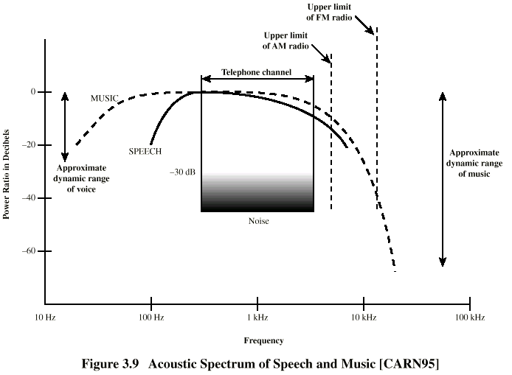
Acoustic Spectrum (Analog)
Notes:
Analog data take on continuous values in some interval, the most familiar example being audio, which, in the form of acoustic sound waves, can be perceived directly by human beings.
Stallings DCC8e Figure 3.9 shows the acoustic spectrum for human speech and for music (note log scales). Frequency components of typical speech may be found between approximately 100 Hz and 7 kHz, and has a dynamic range of about 25 dB (a shout is approx 300 times louder than whisper).
Another common example of analog data is video, as seen on a TV screen.

Slide 31
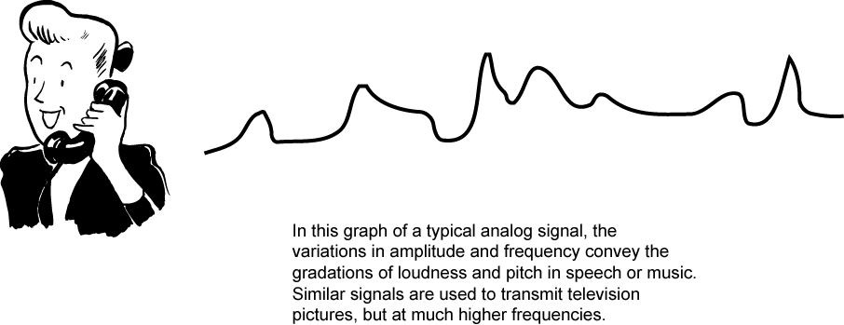
Audio Signals
Freq. range 20Hz-20kHz (speech 100Hz-7kHz)
Easily converted into electromagnetic signals
Varying volume converted to varying voltage
Can limit frequency range for voice channel to 300-3400Hz
Notes:
The most familiar example of analog information is audio/acoustic sound wave information, eg. human speech. It is easily converted to an electromagnetic signal for transmission as shown in Stallings DCC8e Figure 3.12. All of the sound frequencies, whose amplitude is measured in terms of loudness, are converted into electromagnetic frequencies, whose amplitude is measured in volts. The telephone handset contains a simple mechanism for making such a conversion. In the case of acoustic data (voice), the data can be represented directly by an electromagnetic signal occupying the same spectrum. The spectrum of speech is approximately 100 Hz to 7 kHz, although a much narrower bandwidth will produce acceptable voice reproduction. The standard spectrum for a voice channel is 300 to 3400 Hz.

Slide 32
Video Signals
USA - 483 lines per frame, at frames per sec
  have 525 lines but 42 lost during vertical retrace
525 lines x 30 scans = 15750 lines per sec
  63.5μs per line
  11μs for retrace, so 52.5 μs per video line
Max frequency if line alternates black and white
Horizontal resolution is about 450 lines giving 225 cycles of wave in 52.5 μs
Max frequency of 4.2MHz
Notes:
Now consider video signal, produced by a TV camera. The US standard is 525 lines, with 42 lost during vertical retrace. Thus the horizontal scanning frequency is (525 lines) × (30 scan/s) = 15,750 lines per second, or 63.5 µs/line. Of the 63.5 µs, about 11 µs are allowed for horizontal retrace, leaving a total of 52.5 µs per video line. To estimate the bandwidth needed use max frequency when lines alternate black & white. The subjective resolution is about 70% of 525-42, or about 338 lines. Want horizontal and vertical resolutions about the same, and ratio of width to height of a TV screen is 4 : 3, so the horizontal resolution computes to about 4/3 × 338 = 450 lines. As a worst case, a scanning line would be made up of 450 elements alternating black and white, ie 450/2 = 225 cycles of the wave in 52.5 µs, for a maximum frequency of about 4.2 MHz.

Slide 33
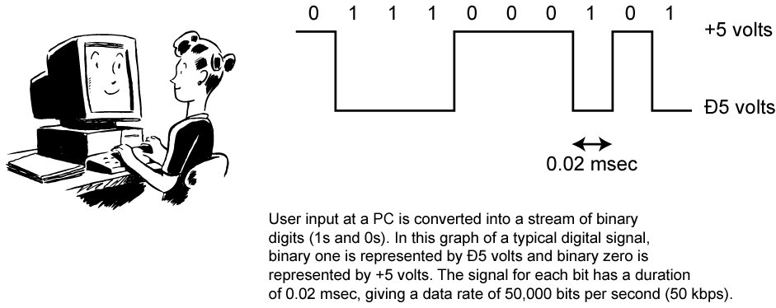
Digital Data
As generated by computers etc.
Has two dc components
Bandwidth depends on data rate
Notes:
Lastly consider binary data, as generated by terminals, computers, and other data processing equipment and then converted into digital voltage pulses for transmission. This is illustrated in Stallings DCC8e Figure 3.13. A commonly used signal for such data uses two constant (dc) voltage levels, one level for binary 1 and one level for binary 0. Consider the bandwidth of such a signal, which depends on the exact shape of the waveform and the sequence of 1s and 0s. The greater the bandwidth of the signal, the more faithfully it approximates a digital pulse stream.

Slide 34
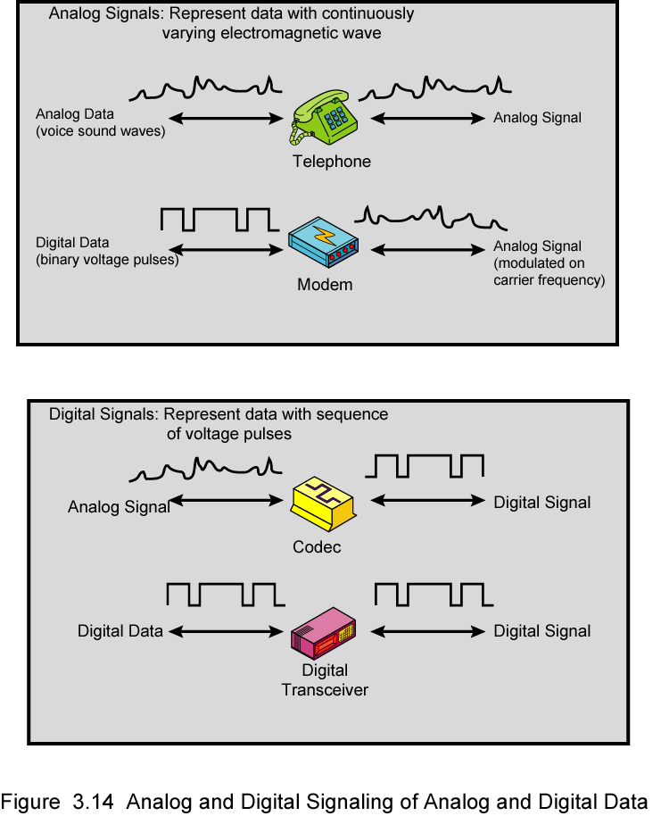
Analog Signals
Notes:
In a communications system, data are propagated from one point to another by means of electromagnetic signals. Both analog and digital signals may be transmitted on suitable transmission media.
An analog signal is a continuously varying electromagnetic wave that may be propagated over a variety of media, depending on spectrum; examples are wire media, such as twisted pair and coaxial cable; fiber optic cable; and unguided media, such as atmosphere or space propagation.
As Stallings DCC8e Figure 3.14 illustrates, analog signals can be used to transmit both analog data represented by an electromagnetic signal occupying the same spectrum, and digital data using a modem (modulator/demodulator) to modulate the digital data on some carrier frequency.
However, analog signal will become weaker (attenuate) after a certain distance. To achieve longer distances, the analog transmission system includes amplifiers that boost the energy in the signal. Unfortunately, the amplifier also boosts the noise components. With amplifiers cascaded to achieve long distances, the signal becomes more and more distorted. For analog data, such as voice, quite a bit of distortion can be tolerated and the data remain intelligible. However, for digital data, cascaded amplifiers will introduce errors.

Slide 35
Digital Signals
Notes:
A digital signal is a sequence of voltage pulses that may be transmitted over a wire medium; eg. a constant positive voltage level may represent binary 0 and a constant negative voltage level may represent binary 1.
As Stallings DCC8e Figure 3.14 also illustrates, digital signals can be used to transmit both analog signals and digital data. Analog data can converted to digital using a codec (coder-decoder), which takes an analog signal that directly represents the voice data and approximates that signal by a bit stream. At the receiving end, the bit stream is used to reconstruct the analog data. Digital data can be directly represented by digital signals.
A digital signal can be transmitted only a limited distance before attenuation, noise, and other impairments endanger the integrity of the data. To achieve greater distances, repeaters are used. A repeater receives the digital signal, recovers the pattern of 1s and 0s, and retransmits a new signal. Thus the attenuation is overcome.

Slide 36
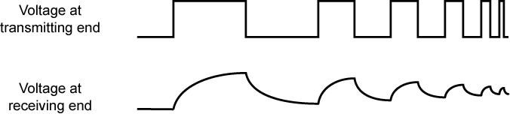
Advantages & Disadvantages of Digital Signals
Cheaper
Less susceptible to noise
But greater attenuation
Digital now preferred choice
Notes:
The principal advantages of digital signaling are that it is generally cheaper than analog signaling and is less susceptible to noise interference. The principal disadvantage is that digital signals suffer more from attenuation than do analog signals. Stallings DCC8e Figure 3.11 shows a sequence of voltage pulses, generated by a source using two voltage levels, and the received voltage some distance down a conducting medium. Because of the attenuation, or reduction, of signal strength at higher frequencies, the pulses become rounded and smaller.
Which is the preferred method of transmission? The answer being supplied by the telecommunications industry and its customers is digital. Both long-haul telecommunications facilities and intra-building services have moved to digital transmission and, where possible, digital signaling techniques, for a range of reasons.

Slide 37
Channel Capacity
Max. possible data rate on a communication channel
Is a function of
  Data rate - in bits per second
  Bandwidth - in cycles per second or Hertz
  Noise - on communication link
  Error rate - of corrupted bits
Limitations due to physical properties
Want most efficient use of capacity
Notes:
The maximum rate at which data can be transmitted over a given communication channel, under given conditions, is referred to as the channel capacity. There are four concepts here that we are trying to relate to one another.
• Data rate, in bits per second (bps), at which data can be communicated
• Bandwidth, as constrained by the transmitter and the nature of the transmission medium, expressed in cycles per second, or Hertz
• Noise, average level of noise over the communications path
• Error rate, at which errors occur, where an error is the reception of a 1 when a 0 was transmitted or the reception of a 0 when a 1 was transmitted
All transmission channels of any practical interest are of limited bandwidth, which arise from the physical properties of the transmission medium or from deliberate limitations at the transmitter on the bandwidth to prevent interference from other sources. Want to make as efficient use as possible of a given bandwidth. For digital data, this means that we would like to get as high a data rate as possible at a particular limit of error rate for a given bandwidth. The main constraint on achieving this efficiency is noise.

Slide 38
Nyquist Bandwidth
Consider noise free channels
If rate of signal transmission is 2B then can carry signal with frequencies no greater than B
  i.e. given bandwidth B, highest signal rate is 2B
For binary signals, 2B bps needs bandwidth B Hz
Can increase rate by using M signal levels
Nyquist Formula is: C = 2B log₂M
So increase rate by increasing signals
  At cost of receiver complexity
  Limited by noise & other impairments
Notes:
Consider a noise free channel where the limitation on data rate is simply the bandwidth of the signal. Nyquist states that if the rate of signal transmission is 2B, then a signal with frequencies no greater than B is sufficient to carry the signal rate. Conversely given a bandwidth of B, the highest signal rate that can be carried is 2B. This limitation is due to the effect of intersymbol interference, such as is produced by delay distortion.
If the signals to be transmitted are binary (two voltage levels), then the data rate that can be supported by B Hz is 2B bps. However signals with more than two levels can be used; that is, each signal element can represent more than one bit. For example, if four possible voltage levels are used as signals, then each signal element can represent two bits. With multilevel signaling, the Nyquist formulation becomes: C = 2B log₂ M, where M is the number of discrete signal or voltage levels.
So, for a given bandwidth, the data rate can be increased by increasing the number of different signal elements. However, this places an increased burden on the receiver, as it must distinguish one of M possible signal elements. Noise and other impairments on the transmission line will limit the practical value of M.

Slide 39
Shannon Capacity Formula
Consider relation of data rate, noise & error rate
  Faster data rate shortens each bit so bursts of noise affect more bits
  Given noise level, higher rates mean higher errors
Shannon developed formula relating these to signal to noise ratio (in decibels)
SNR_{db}⁼10 log₁₀ (signal/noise)
Capacity C=B log₂(1+SNR)
  Theoretical maximum capacity
  Gets lower in practice
Notes:
Consider the relationship among data rate, noise, and error rate. The presence of noise can corrupt one or more bits. If the data rate is increased, then the bits become "shorter" so that more bits are affected by a given pattern of noise. Mathematician Claude Shannondeveloped a formula relating these. For a given level of noise, expect that a greater signal strength would improve the ability to receive data correctly in the presence of noise. The key parameter involved is the signal-to-noise ratio (SNR, or S/N), which is the ratio of the power in a signal to the power contained in the noise that is present at a particular point in the transmission. Typically, this ratio is measured at a receiver, because it is at this point that an attempt is made to process the signal and recover the data. For convenience, this ratio is often reported in decibels. This expresses the amount, in decibels, that the intended signal exceeds the noise level. A high SNR will mean a high-quality signal and a low number of required intermediate repeaters.
The signal-to-noise ratio is important in the transmission of digital data because it sets the upper bound on the achievable data rate. Shannon's result is that the maximum channel capacity, in bits per second, obeys the equation shown. C is the capacity of the channel in bits per second and B is the bandwidth of the channel in Hertz. The Shannon formula represents the theoretical maximum that can be achieved. In practice, however, only much lower rates are achieved, in part because formula only assumes white noise (thermal noise).

Slide 40
Problem
Suppose the spectrum is between 3Mhz and 4 MHz and SNR_{db} = 24. Calculate channel capacity using Shannon and Nyquist.

Slide 41
Summary
Looked at data transmission issues
Frequency, spectrum & bandwidth
Analog vs digital signals
Transmission impairments
Notes:
Stallings DCC8e Chapter 3 summary.

